Slide 1
Foundations of Data Science & Analytics
Rochester Institute of Technology | 1
Presented by: Basanth Varaganti
Email Id: bv8946@g.rit.edu
https://github.com/Basanth08/DSCI-633.git

Slide 2

The objective of this project is to be develop a machine learning model to detect fraudulent job postings.
Rochester Institute of Technology | 2

Slide 3
Developing a Custom SVM-based Model for Detecting Fraudulent Job Postings using TF-IDF Feature Extraction and Hyperparameter Tuning
Rochester Institute of Technology | 3
Custom Machine Learning Model
Text Feature Extraction with TF-IDF
Hyperparameter Tuning with RandomizedSearchCV
Stratified k-Fold Cross-Validation
Custom Evaluation Metrics

Slide 4
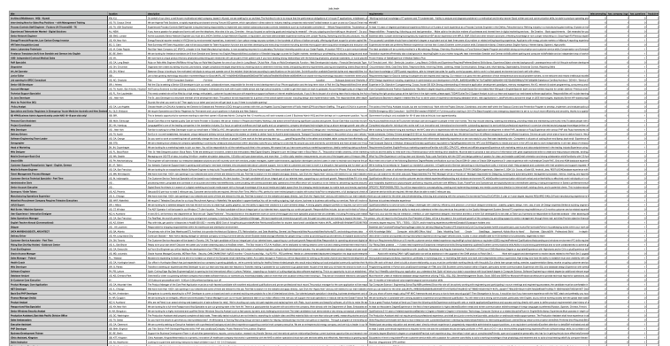
An overview of the Data Set :
Rochester Institute of Technology | 4
The data set consists of the following column’s :
Title
Location
Description
Requirements
Telecommuting
has_company_logo
has_questions
fraudulent

Slide 5
Data Pre-processing Techniques for Text Classification: From Raw Descriptions to Meaningful Features
Rochester Institute of Technology | 5
Efficient Data Loading and Handling
Text Feature Extraction with TF-IDF
Dimensionality Reduction and Feature Selection
Data Splitting for Model Evaluation
Scalability and Flexibility

Slide 6
Investigating the Impact of Feature Selection Techniques on Text Classification Performance
Rochester Institute of Technology | 6
Dimensionality Reduction
Removing Irrelevant and Redundant Features
Improving Model Interpretability
Enhancing Computational Efficiency
Experimentation and Evaluation

Slide 7
Enhancing Text Classification through Feature Selection Techniques
Rochester Institute of Technology | 7
Feature Selection Techniques
Selected Features
( Reduced Dimensions)
Initial Set of Features
Relevance Scoring
Improved Model Performance
Feature Count
Subset Selection

Slide 8
Comparative Analysis of Classifier Performance in Text Classification
Rochester Institute of Technology | 8
PassiveAggressiveClassifier with TfidfVectorizer and CountVectorizer
KNeighborsClassifier
RandomForestClassifier
SVC (Support Vector Classifier)
SGDClassifier (Stochastic Gradient Descent Classifier)
LogisticRegression

Slide 9
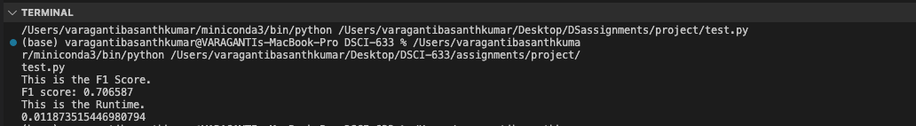
PassiveAggressiveClassifier with TfidfVectorizer
Rochester Institute of Technology | 9

Slide 10
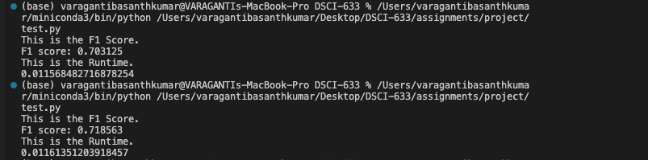
PassiveAggressiveClassifier with CountVectorizer
Rochester Institute of Technology | 10

Slide 11
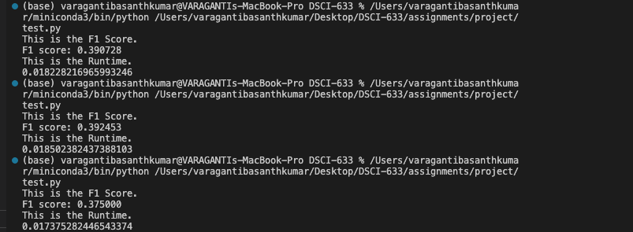
KNeighborsClassifier
Rochester Institute of Technology | 11

Slide 12
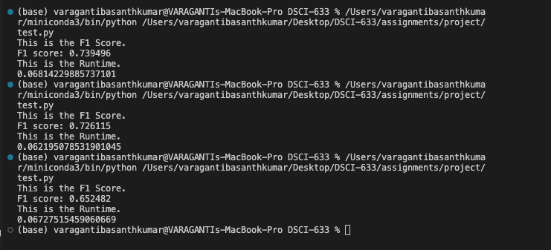
RandomForestClassifier
Rochester Institute of Technology | 12

Slide 13
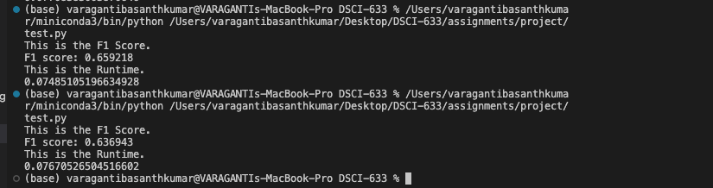
SVC (Support Vector Classifier)
Rochester Institute of Technology | 13

Slide 14
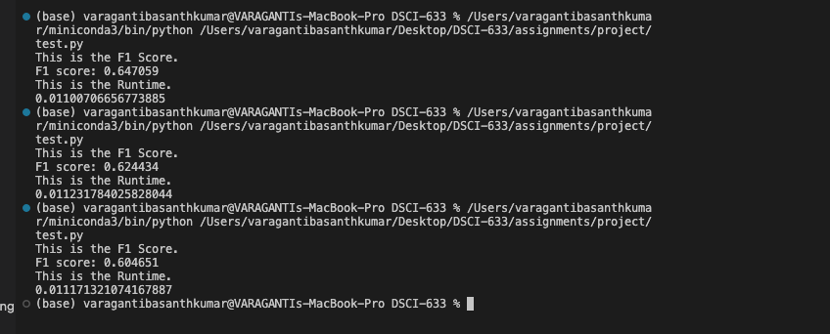
SGDClassifier (Stochastic Gradient Descent Classifier)
Rochester Institute of Technology | 14

Slide 15
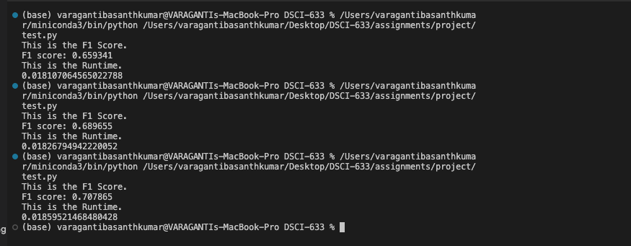
LogisticRegression
Rochester Institute of Technology | 15

Slide 16
Comparative Evaluation of Classifier Performance and Hyperparameter Settings
Rochester Institute of Technology | 16
Classifier | Hyperparameters | F1 Score
Passive Aggressive Classifier | TfidfVectorizer, CountVectorizer | 0.70 0.71
KNeighborsClassifier | n_neighbors=1 | 0.39
RandomForestClassifier | n_estimators=100, class_weight="balanced" | 0.72
SVC | kernel='rbf' | 0.65
SGDClassifier | class_weight="balanced", max_iter=3000, random_state=45 | 0.64
LogisticRegression | solver='liblinear', random_state=0 | 0.65

Slide 17
Approach to Hyperparameter Tuning
Rochester Institute of Technology | 17
Define the Hyperparameter Search Space
Select a Tuning Strategy
Perform Cross-Validation
Evaluate Performance Metrics
Analyse and Interpret Results
Select the Optimal Hyperparameters
Validate and Fine-tune

Slide 18
Impact of Hyperparameter Tuning
Rochester Institute of Technology | 18
Results:
Significant improvement in model performance after tuning hyperparameters
Optimal hyperparameter configurations identified for each classifier
Best-performing models achieved higher accuracy, precision, recall, and F1 scores
Key Findings:
Hyperparameter tuning had a substantial impact on model performance
Different classifiers responded differently to hyperparameter adjustments
Optimal hyperparameters varied depending on the specific classifier and dataset

Slide 19
Rochester Institute of Technology | 19
Performance Comparison:
Provide a table or graph comparing the performance metrics before and after tuning
Highlight the percentage improvement in metrics for each classifier
Identify the top-performing models based on the tuned hyperparameters
Insights:
Discuss the most influential hyperparameters for each classifier
Analyse the relationship between hyperparameter values and model performance
Identify any trade-offs or diminishing returns observed during tuning

Slide 20
Rochester Institute of Technology | 20
Best Hyperparameter Configurations:
Present the optimal hyperparameter settings for each classifier
Explain how these configurations strike a balance between performance and complexity
Discuss the implications of these configurations for model deployment and scalability
Validation Results:
Report the final performance metrics obtained on the held-out test set
Confirm the generalization ability of the tuned models
Discuss any discrepancies between validation and test set performance

Slide 21
Rochester Institute of Technology | 21
Lessons Learned:
Emphasize the importance of hyperparameter tuning in optimizing model performance
Highlight the need for systematic experimentation and evidence-based decision-making
Discuss the role of domain knowledge and intuition in guiding the tuning process

Slide 22
Rochester Institute of Technology | 22
Support Vector Machine (SVM)
The hyperparameters for the SVM classifier are defined in the HyperParameterGrid dictionary. The hyperparameters being tuned are:
C: Regularization parameter
It controls the trade-off between training error and testing error.
The values considered for C are [0.1, 1, 10, 100].
A smaller value of C allows for more regularization and a simpler decision boundary, while a larger value of C allows for a more complex decision boundary and potentially better fit to the training data.

Slide 23
Rochester Institute of Technology | 23
2. kernel: Kernel function It specifies the kernel used in the SVM algorithm.
The values considered for kernel are ['linear', 'rbf', 'poly'].
The 'linear' kernel is suitable for linearly separable data.
The 'rbf' (radial basis function) kernel is commonly used for non-linearly separable data and can handle complex decision boundaries.
The 'poly' (polynomial) kernel allows for modelling higher-order relationships between features.

Slide 24
Rochester Institute of Technology | 24
3. gamma: Kernel coefficient It determines the influence of a single training example on the decision boundary.
The values considered for gamma are ['scale', 'auto'].
When gamma is set to 'scale', it is calculated as 1 / (n_features * X.var()), where n_features is the number of features and X.var() is the variance of the input data.
When gamma is set to 'auto', it is equal to 1 / n_features.
A smaller value of gamma results in a wider influence of each training example, while a larger value of gamma leads to a more localized influence.

Slide 25
Rochester Institute of Technology | 25
The result of tuning the hyperparameters using RandomizedSearchCV is stored in the optimized_params variable, which contains the best hyperparameter configuration found during the search.
# Getting the best optimized hyperparameters
optimized_params = param_search.best_params_
The ** operator unpacks the optimized_params dictionary and passes the hyperparameters as keyword arguments to the SVC constructor.
self.SVMFinalModel = SVC(**optimized_params)

Slide 26
Rochester Institute of Technology | 26
Finally, the optimized SVM model is trained on the pre-processed text data using the fit method:
self.SVMFinalModel.fit(transform_variable, y)

Slide 27
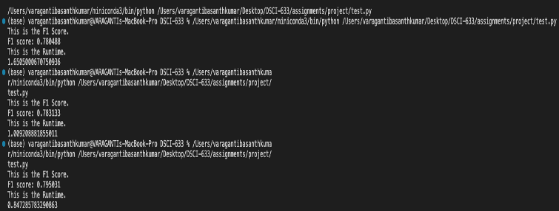
Rochester Institute of Technology | 27
Project Outputs:

